Slide 1

Computer Data
Representation,
Register Transfer and
Micro-operations
Diploma Studies
Computer Engineering
Unit – 1
Title - Computer Data Representation & Register Transfer and Micro-operations
Computer Organization (09CE2401)

Slide 2
Computer Architecture
Computer architecture refers to the structure and organization of a computer system, encompassing its hardware components and the way they interact to execute instructions and perform tasks. It involves the design and layout of various elements that constitute a computer, providing a framework for how data is processed, stored, and communicated within the system. Computer architecture serves as a blueprint for building and understanding the functionality of computers.

Slide 3
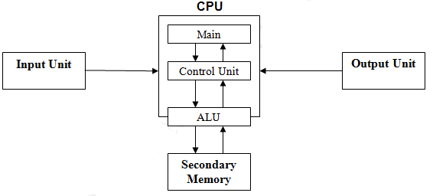
Computer Architecture
X, Y
Z
Calculator:
X=5, y=10
Z=x+y
Z=5+10

Slide 4
Computer Organization
Computer organization refers to the way in which the various hardware components of a computer system are arranged and connected to perform specified functions. While computer architecture focuses on the high-level design and conceptual structure of a computer system, computer organization delves into the details of how these components are implemented and interconnected to carry out the instructions specified by the architecture.

Slide 5
Data Representation
(1) Numeric data
--Numbers (real, Integer)
(2) Non-numeric data
--letters, symbols
(3) Data structures
--list, tree, stack etc...
Program and many more...

Slide 6
Numeric Data Representation
Decimal
Binary
Octal
Hexadecimal

Slide 7
Decimal
Decimal digits (0, 1, 2, 3, 4, 5, 6, 7, 8, 9) to represent numbers, and refer to the system as the decimal system.
The decimal system is said to have a base, or radix, of 10.
This means that each digit in the number is multiplied by 10 raised to a power corresponding to that digits position

Slide 8


Decimal
The same principle holds for decimal fractions, but negative powers of 10 are used.

Slide 9

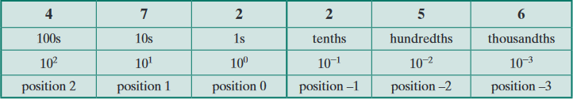
Decimal
A number with both an integer and fractional part has digits raised to both positive and negative powers of 10:
MSB
LSB

Slide 10
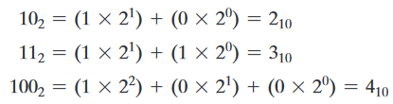
Binary
In the binary system, we have only two digits, 1 and 0. Thus, numbers in the binary system are represented to base 2.

Slide 11

Octal
In the octal system (radix 8). The eight symbols are 0, 1, 2, 3, 4, 5, 6, and 7.

Slide 12
Hexadecimal
Hexadecimal (radix 16) , The 16 symbols of the hexadecimal system are 0, 1, 2, 3, 4, 5, 6, 7, 8, 9, A, B, C, 0, E, and F.
The last six symbols are, unfortunately, identical to the letters of the alphabet and can cause confusion at times.
However, this is the convention that has been adopted.

Slide 13
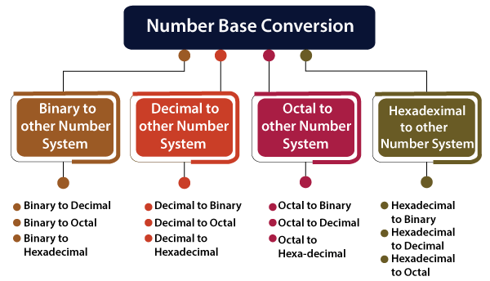
Number Base Conversion
As, we have four types of number systems so each one can be converted into the remaining three systems. There are the following conversions possible in Number System
Binary to other Number Systems.
Decimal to other Number Systems.
Octal to other Number Systems.
Hexadecimal to other Number Systems.

Slide 14
Binary to other Number Systems
There are three conversions possible for binary number, i.e., binary to decimal, binary to octal, and binary to hexadecimal.
The conversion process of a binary number to decimal differs from the remaining others.
Let's take a detailed discussion on Binary Number System conversion.

Slide 15
Binary to Decimal Conversion
The process of converting binary to decimal is quite simple.
The process starts from multiplying the bits of binary number with its corresponding positional weights.
And lastly, we add all those products.
Example 1: (10110.001)2
We multiplied each bit of (10110.001)2 with its respective positional weight, and last we add the products of all the bits with its weight.
(10110.001)2=(1×2⁴)+(0×2³)+(1×2²)+(1×2¹)+(0×2⁰) + (0×2⁻¹)+(0×2⁻²)+(1×2⁻³)
(10110.001)2=(1×16)+(0×8)+(1×4)+(1×2)+(0×1) + (0×1⁄2)+(0×1⁄4)+(1×1⁄8)
(10110.001)2=16+0+4+2+0+0+0+0.125
(10110.001)2=(22.125 )10

Slide 16
Binary to Octal Conversion
The base numbers of binary and octal are 2 and 8, respectively.
In a binary number, the pair of three bits is equal to one octal digit.
There are only two steps to convert a binary number into an octal number which are as follows:
In the first step, we have to make the pairs of three bits on both sides of the binary point. If there will be one or two bits left in a pair of three bits pair, we add the required number of zeros on extreme sides.
2. In the second step, we write the octal digits corresponding to each pair.

Slide 17
Binary to Octal Conversion - Example
Example 1: (111110101011.0011)2
1. Firstly, we make pairs of three bits on both sides of the binary point.
111 110 101 011.001 1
On the right side of the binary point, the last pair has only one bit.
To make it a complete pair of three bits, we added two zeros on the extreme side.
111 110 101 011.001 100
2. Then, we wrote the octal digits, which correspond to each pair.
(111110101011.0011)2=(7653.14)8

Slide 18
Binary to Hexadecimal Conversion
The base numbers of binary and hexadecimal are 2 and 16, respectively.
In a binary number, the pair of four bits is equal to one hexadecimal digit.
There are also only two steps to convert a binary number into a hexadecimal number which are as follows:
In the first step, we have to make the pairs of four bits on both sides of the binary point.
If there will be one, two, or three bits left in a pair of four bits pair, we add the required number of zeros on extreme sides.
2. In the second step, we write the hexadecimal digits corresponding to each pair.

Slide 19
Binary to Hexadecimal Conversion - Example
Example 1: (10110101011.0011)2
1. Firstly, we make pairs of four bits on both sides of the binary point.
111 1010 1011.0011
On the left side of the binary point, the first pair has three bits. To make it a complete pair of four bits, add one zero on the extreme side.
0111 1010 1011.0011
2. Then, we write the hexadecimal digits, which correspond to each pair.
(011110101011.0011)2=(7AB.3)16

Slide 20
Decimal to other Number System

Slide 21
Decimal to other Number System
The decimal number can be an integer or floating-point integer.
When the decimal number is a floating-point integer, then we convert both part (integer and fractional) of the decimal number in the isolated form(individually).
There are the following steps that are used to convert the decimal number into a similar number of any base 'r'.
1. In the first step, we perform the division operation on integer and successive part with base 'r'. We will list down all the remainders till the quotient is zero. Then we find out the remainders in reverse order for getting the integer part of the equivalent number of base 'r'. In this, the least and most significant digits are denoted by the first and the last remainders.
2. In the next step, the multiplication operation is done with base 'r' of the fractional and successive fraction. The carries are noted until the result is zero or when the required number of the equivalent digit is obtained. For getting the fractional part of the equivalent number of base 'r', the normal sequence of carrying is considered.

Slide 22
Decimal to Binary Conversion
For converting decimal to binary, there are two steps required to perform, which are as follows:
1. In the first step, we perform the division operation on the integer and the successive quotient with the base of binary(2).
2. Next, we perform the multiplication on the integer and the successive quotient with the base of binary(2).

Slide 23
Decimal to Binary Conversion - Example
Example 1: (152.25)10
Step 1:
Divide the number 152 and its successive quotients with base 2.
(152)10=(10011000)2
Example 1: (152.25)10
Step 2:
Now, perform the multiplication of 0.27 and successive fraction with base 2.
(0.25)10=(.01)2
Operation | Quotient | Remainder
152/2 | 76 | 0 (LSB)
76/2 | 38 | 0
38/2 | 19 | 0
19/2 | 9 | 1
9/2 | 4 | 1
4/2 | 2 | 0
2/2 | 1 | 0
1/2 | 0 | 1(MSB)
Operation | Result | carry
0.25×2 | 0.50 | 0
0.50×2 | 0 | 1

Slide 24
Decimal to Octal Conversion
For converting decimal to octal, there are two steps required to perform, which are as follows:
1. In the first step, we perform the division operation on the integer and the successive quotient with the base of octal(8).
2. Next, we perform the multiplication on the integer and the successive quotient with the base of octal(8).

Slide 25
Octal to other Number System

Slide 26
Octal to other Number System
Like binary and decimal, the octal number can also be converted into other number systems.
The process of converting octal to decimal differs from the remaining one.
Let's start understanding how conversion is done.

Slide 27
Octal to Decimal Conversion
The process of converting octal to decimal is the same as binary to decimal.
The process starts from multiplying the digits of octal numbers with its corresponding positional weights. And lastly, we add all those products.
Let's take an example to understand how the conversion is done from octal to decimal.
Example 1: (152.25)8
Step 1:We multiply each digit of 152.25 with its respective positional weight, and last we add the products of all the bits with its weight.
(152.25)8=(1×8²)+(5×8¹)+(2×8⁰)+(2×8⁻¹)+(5×8⁻²)
(152.25)8=64+40+2+(2×1⁄8)+(5×1⁄64)
(152.25)8=64+40+2+0.25+0.078125
(152.25)8=106.328125
So, the decimal number of the octal number 152.25 is 106.328125

Slide 28
Octal to Binary Conversion
The process of converting octal to binary is the reverse process of binary to octal. We write the three bits binary code of each octal number digit.
Example 1: (152.25)8
We write the three-bit binary digit for 1, 5, 2, and 5.
(152.25)8=(001101010.010101)2
So, the binary number of the octal number 152.25 is (001101010.010101)2

Slide 29
Octal to hexadecimal conversion
For converting octal to hexadecimal, there are two steps required to perform, which are as follows:
1. In the first step, we will find the binary equivalent of number.
2. Next, we have to make the pairs of four bits on both sides of the binary point.
If there will be one, two, or three bits left in a pair of four bits pair, we add the required number of zeros on extreme sides and write the hexadecimal digits corresponding to each pair.

Slide 30
Octal to hexadecimal conversion - Example
Example 1: (152.25)8
Step 1: We write the three-bit binary digit for 1, 5, 2, and 5.
(152.25)8=(001101010.010101)2
So, the binary number of the octal number 152.25 is (001101010.010101)2
Step 2:
Now, we make pairs of four bits on both sides of the binary point.
0 0110 1010.0101 01

Slide 31
Octal to hexadecimal conversion - Example
On the left side of the binary point, the first pair has only one digit, and on the right side, the last pair has only two-digit.
To make them complete pairs of four bits, add zeros on extreme sides.
0000 0110 1010.0101 0100
2. Now, we write the hexadecimal digits, which correspond to each pair.
(0000 0110 1010.0101 0100)2=(6A.54)16

Slide 32
Hexa-decimal to other Number System

Slide 33
Hexa-decimal to Decimal Conversion
The process of converting hexadecimal to decimal is the same as binary to decimal.
The process starts from multiplying the digits of hexadecimal numbers with its corresponding positional weights. And lastly, we add all those products.

Slide 34
Hexa-decimal to Decimal Conversion - Example
Example 1: (152A.25)16
Step 1:We multiply each digit of 152A.25 with its respective positional weight, and last we add the products of all the bits with its weight.
(152A.25)16=(1×16³)+(5×16²)+(2×16¹)+(A×16⁰)+(2×16⁻¹)+(5×16⁻²)
(152A.25)16=(1×4096)+(5×256)+(2×16)+(10×1)+(2×16-1)+(5×16-2)
(152A.25)16=4096+1280+32+10+(2×1⁄16)+(5×1⁄256)
(152A.25)16=5418+0.125+0.125
(152A.25)16=5418.14453125
So, the decimal number of the hexadecimal number 152A.25 is 5418.14453125

Slide 35
Hexadecimal to Binary Conversion
The process of converting hexadecimal to binary is the reverse process of binary to hexadecimal.
We write the four bits binary code of each hexadecimal number digit.
Example 1: (152A.25)16
We write the four-bit binary digit for 1, 5, A, 2, and 5.
(152A.25)16=(0001 0101 0010 1010.0010 0101)2

Slide 36
Hexadecimal to Octal Conversion
For converting hexadecimal to octal, there are two steps required to perform, which are as follows:
1. In the first step, we will find the binary equivalent of the hexadecimal number.
2. Next, we have to make the pairs of three bits on both sides of the binary point. If there will be one or two bits left in a pair of three bits pair, we add the required number of zeros on extreme sides and write the octal digits corresponding to each pair.

Slide 37
Hexadecimal to Octal Conversion - Example
Example 1: (152A.25)16
Step 1: We write the four-bit binary digit for 1, 5, 2, A, and 5.
(152A.25)16=(0001 0101 0010 1010.0010 0101)2
So, the binary number of hexadecimal number 152A.25 is (0011010101010.010101)2
Step 2: Then, we make pairs of three bits on both sides of the binary point.
001 010 100 101 010.001 001 010
Then, we write the octal digit, which corresponds to each pair.
(001010100101010.001001010)2=(12452.112)8

Slide 38
1’s Complements
Note:- 1’s and 2’s complement can easily determined on Binary Number Only.
(45) = (101101)
1’s Complement:-
To find 1’s Complement, Just reverse the bits of Binary Value (0 -> 1, 1-> 0).
Binary 1 0 1 1 0 1
1’s Complement 0 1 0 0 1 0
10
2

Slide 39
2’s Complements
To Find 2’s complement, Just add 1 in the 1’s Complement.
(45) = (101101)
1’s Complement:-
To find 1’s Complement, Just reverse the bits of Binary Value (0 -> 1, 1-> 0).
Binary 1 0 1 1 0 1
1’s Complement 0 1 0 0 1 0
1
-----------------
2’s Complement 0 1 0 0 1 1
10
2

Slide 40
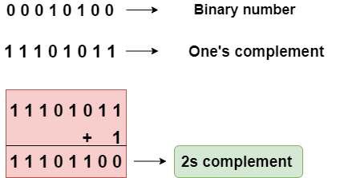
2’s complement

Slide 41
2’s Complements
Directly Find 2’s Complement form Binary Number
From the Right to Left of Binary Number, find the 1st 1, and write the same Binary Value.
After the First 1, Reverse the remaining Bits of Binary Value.
Examples:
(1) (101010)
(2) (10100)
(3) (100101)

Slide 42
Complement No. System
To Find (n-1)’s Complement of any given base, Find the highest Number of that base .
For Ex. (1) (_ _ _) -> (5 5 5)
(2) (_ _ _) -> (9 9 9)
N’s Complement (Radix/Base)
(n-1)’s Complement (Diminished Radix/Base)
(nk-1)
(nk-1)-x
N = Radix / Base
X =Given Number
K – Total Digits in x
6
10

Slide 43
Complement No. System
Example 1:- (123) <- Given Number,
Base/Radix is 8
Max Number is 7
So, 7 7 7 <- Radix Number
- 1 2 3 <- Given Number
-------------
6 5 4 <- (n-1)’s Complement [7’s Complement]
+ 1
---------------
6 5 5 <- (n)’s Complement [8’s Complement]
8

Slide 44
Complement No. System
Example 2:- (123) <- Given Number,
Base/Radix is 16
Max Number is 15
So, 15 15 15 -> (F F F) <- Radix Number
- 1 2 3 <- Given Number
-------------
E D C <- (n-1)’s Complement [15’s Complement]
+ 1
---------------
E D D <- (n)’s Complement [16’s Complement]
16

Slide 45
Register Transfer Language
The digital system modules are constructed from such digital components as register, decoders, arithmetic elements, and control logic.
Register holds some data and operations are performed on them (micro-operations like clear, load, shift etc..)
The symbolic notation used to describe the micro-operation transfers among registers is called a register transfer language.

Slide 46
Register Transfer Language
The term "register transfer" implies the availability of hardware logic circuits that can perform a stated micro operation, The word "language" is borrowed from programmers

Slide 47
Register Transfer
Register is a very fast computer memory, used to store data/instruction in execution.
A Register is a group of flip-flops with each flip-flop capable of storing one bit of information.
An n-bit register has a group of n flip-flops and is capable of storing binary information of n-bits.

Slide 48
Register Transfer
The registers used by the CPU are often termed as Processor Registers.
A Processor Register may hold an instruction, a storage address, or any data.
The computer needs processor registers for manipulating data and a register holding a memory address.
The register holding the memory location is used to calculate the address of the next instruction after the execution of the current instruction is completed

Slide 49
Some commonly used Register
(1) Accumulator: This is the most common register, used to store data taken out from the memory.
(2) General Purpose Registers: This is used to store data intermediate results during program execution. It can be accessed via assembly programming.

Slide 50
Some commonly used Register
(3) Special Purpose Registers:
Users do not access these registers. These registers are for computer systems.
MAR: Memory Address Register are those registers that holds the address for the memory unit.
MBR: Memory Buffer Register stores instructions and data received from the memory and sent from the memory.
PC: Program Counter points to the next instruction to be executed.
IR: Instruction Register holds the instruction to be executed.

Slide 51
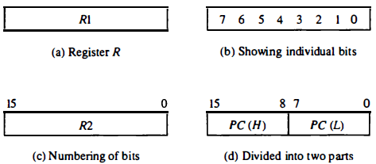
Register Transfer
The term Register Transfer means the availability of Hardware Logic Circuits that can perform a stated micro-operation and transfer the result of the operation to the same or another register.
L = Low Bit H = High Bit

Slide 52
Register Transfer
Register and Memory configuration for a basic computer
Register | Symbol | No. of Bits | Function
Data Register | DR | 16 | Holds memory operand
Accumulator | AC | 16 | Processor Register
Program Counter | PC | 12 | Holds Address of the Instruction
Address Register | AR | 12 | Holds Address for the memory
Instruction Register | IR | 16 | Holds instruction code
Temporary Register | TR | 16 | Holds temporary data
Input Register | INPR | 8 | Carries Input character
Output Register | OUTR | 8 | Carries output character

Slide 53
Register Transfer
Basic Symbols used for Register Transfer
Symbol | Description | Example
Letters and Numbers | Denotes a Register | MAR, R1, R2
( ) | Denotes a part of register | R1(8-bit) R1(0-7)
<- | Denotes a transfer of information | R2 <- R1
, | Separate two micro-operations | R1<-R2, R2<-R1
: | Denotes conditional operations | P : R2 <- R1 if P=1
Naming Operator (:=) | Denotes another name for an already existing register/alias | Ra := R1

Slide 54
Register Transfer
←
Destination
R2
Source
R1
a transfer of the content of register R1 into R2.
And a replacement of the content of R2 by the content of R1.
The content of the source register R1 does not change after the transfer

Slide 55
Register Transfer (predetermined condition)
If (P = 1)
then
(R2 ← R1)
transfer to occur only under a predetermined condition.

Slide 56
Register Transfer (Control function)
P: R2 ←R1
A control function (terminated with colon) is a Boolean variable that is equal to 1 or 0.
It symbolizes the requirement that the transfer operation be executed by the hardware only if P = 1

Slide 57
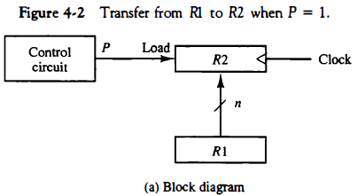
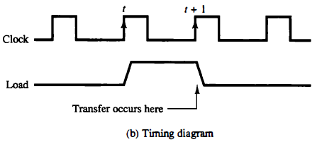

Slide 58
Register Transfer (Control function)
T: R2 ←R1, R1←R2
The arrow denotes a transfer of information and the direction of transfer.
A comma is used to separate two or more operations that are executed at the same time

Slide 59
Bus and Memory Transfers
Digital computers has many registers.
R1
R10
R2
R9
R3
R8
R4
R7
R5
R6

Slide 60
Bus and Memory Transfers
Digital computers has many registers.
Must have path for information transfer, one to another
Number of wires will be excessive if separate wires used.
Solution –
Using common bus system

Slide 61
Bus and Memory Transfers
Common Bus System - for transferring information between registers in a multiple-register configuration is a common bus system.
It consists of a set of common lines, one for each bit of a register, through which binary information is transferred one at a time.

Slide 62
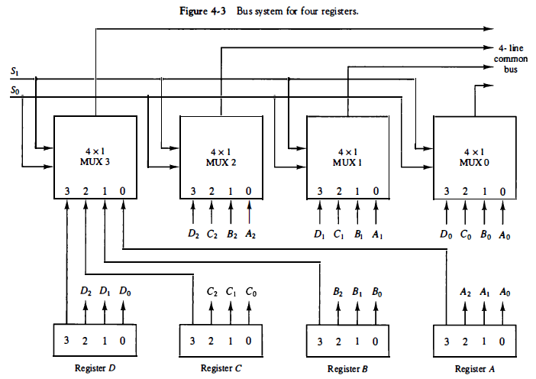
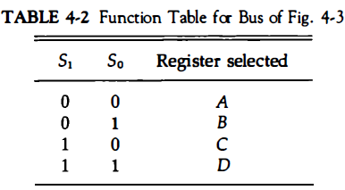
Common Bus System

Slide 63
Common Bus System
The following block diagram shows a Bus system for four registers.
It is constructed with the help of four 4 * 1 Multiplexers each having four data inputs (0 through 3) and two selection inputs (S1 and S2).
We have used labels to make it more convenient for you to understand the input-output configuration of a Bus system for four registers.
For instance, output 1 of register A is connected to input 0 of MUX1.
The two selection lines S1 and S2 are connected to the selection inputs of all four multiplexers. The selection lines choose the four bits of one register and transfer them into the four-line common bus.

Slide 64
Common Bus System
When both of the select lines are at low logic, i.e. S1S0 = 00, the 0 data inputs of all four multiplexers are selected and applied to the outputs that form the bus.
This, in turn, causes the bus lines to receive the content of register A since the outputs of this register are connected to the 0 data inputs of the multiplexers.
Similarly, when S1S0 = 01, register B is selected, and the bus lines will receive the content provided by register B.

Slide 65
Tri-State Bus Buffers (3 State Buffer)
A bus system constructed with three-state gates instead of multiplexers, a digital circuit that exhibits three states.
Two of the states equivalent to logic 1 and 0 as in a conventional gate. The third state is a high-impedance state.
The high-impedance state behaves like an open circuit, means that the output is disconnected and does not have a logic significance. commonly used in the design of a bus system is the buffer gate.
Buffer Gate is used when we wants to add some delay in our output

Slide 66
Tri-State Bus Buffers (3 State Buffer)
Definition:
A three-state bus buffer is an integrated circuit that connects multiple data sources to a single bus. The open drivers can be selected to be either a logical high, a logical low, or high impedance which allows other buffers to drive the bus.
Now, let’s see the more detailed analysis of a 3-state bus buffer in points:
As in a conventional gate, 1 and 0 are two states.
The third state is a high impedance state.
The third state behaves like an open circuit.
If the output is not connected, then there is no logical significance.
It may perform any type of conventional logic operations such as AND, OR, NAND, etc.

Slide 67
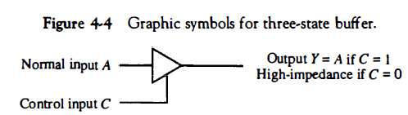
Tri-State Bus Buffers (3 State Buffer)

Slide 68
Tri-State Bus Buffers (3 State Buffer)
Normal Input A
Output Y = A if C=1
High-impedance if C = 0
Control Input C

Slide 69
Common bus System using decoder and tri-state Buffers
A0
B0
C0
D0
1
0
S1
Select
2 * 4
Decoder
1
0
S2
1
2
Enable
E
3

Slide 70
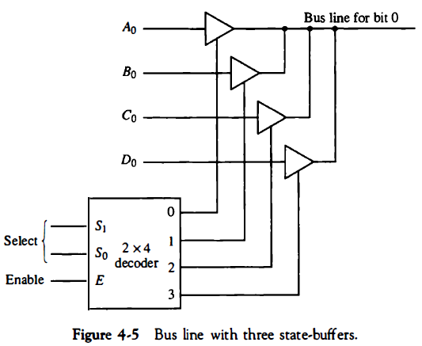
Tri-State Bus Buffers (3 State Buffer)

Slide 71
Logic Gates
Logic gates are the basic building blocks of any digital system.
It is an electronic circuit having one or more than one input and only one output.
The relationship between the input and the output is based on a certain logic. Based on this, logic gates are named as AND gate, OR gate, NOT gate etc.
Different Logic Gates are as listed below:
AND Gate
OR Gate
NOT Gate
NAND Gate
NOR Gate
XOR Gate
XNOR Gate

Slide 72

Logic Gates – AND Gate
A circuit which performs an AND operation is shown in figure. It has n input (n >= 2) and one output.
Logic diagram: A*B
Truth Table
Inputs |  | Output
A | B | A and B
0 | 0 | 0
0 | 1 | 0
1 | 0 | 0
1 | 1 | 1

Slide 73

Logic Gates – OR Gate
A circuit which performs an OR operation is shown in figure. It has n input (n >= 2) and one output.
Logic diagram: A*B
Truth Table
Inputs |  | Output
A | B | A OR B
0 | 0
0
0 | 1
1
1 | 0
1
1 | 1
1

Slide 74


Logic Gates – NOT Gate
NOT gate is also known as Inverter. It has one input A and one output Y.
Logic diagram: A*B
Truth Table
Input | Output
0
1
1
0

Slide 75


Logic Gates – NAND Gate
A NOT-AND operation is known as NAND operation. It has n input (n >= 2) and one output.
Logic diagram: A*B
Truth Table
Inputs |  | Output
A | B | A B
0 | 0
1
0 | 1
1
1 | 0
1
1 | 1
0

Slide 76

Logic Gates – NOR Gate
A NOT-OR operation is known as NOR operation. It has n input (n >= 2) and one output.
Logic diagram:
Truth Table
Inputs |  | Output
A | B | A + B
0 | 0
1
0 | 1
0
1 | 0
0
1 | 1
0

Slide 77


Logic Gates – XOR Gate
XOR or Ex-OR gate is a special type of gate. It can be used in the half adder, full adder and subtractor.
The exclusive-OR gate is abbreviated as EX-OR gate or sometime as X-OR gate. It has n input (n >= 2) and one output.
Logic diagram:
Truth Table
Inputs |  | Output
A | B | A + B
0 | 0
0
0 | 1
1
1 | 0
1
1 | 1
0

Slide 78


Logic Gates – XNOR Gate
XNOR gate is a special type of gate. It can be used in the half adder, full adder and subtractor.
The exclusive-NOR gate is abbreviated as EX-NOR gate or sometime as X-NOR gate. It has n input (n >= 2) and one output.
Logic diagram:
Truth Table
Inputs |  | Output
A | B | A - B
0 | 0
1
0 | 1
0
1 | 0
0
1 | 1
1

Slide 79
Arithmetic Micro-operations
In general, the Arithmetic Micro-operations deals with the operations performed on numeric data stored in the registers.
The basic Arithmetic Micro-operations are classified in the following categories:
Addition
Subtraction
Increment
Decrement
Shift

Slide 80
Arithmetic Micro-operations
The following table shows the symbolic representation of various Arithmetic Micro-operations.
Symbolic Representation | Description
R3 ← R1 + R2 | The contents of R1 plus R2 are transferred to R3.
R3 ← R1 - R2 | The contents of R1 minus R2 are transferred to R3.
R2 ← R2' | Complement the contents of R2 (1's complement)
R2 ← R2' + 1 | 2's complement the contents of R2 (negate)
R3 ← R1 + R2' + 1 | R1 plus the 2's complement of R2 (subtraction)
R1 ← R1 + 1 | Increment the contents of R1 by one
R1 ← R1 - 1 | Decrement the contents of R1 by one

Slide 81
Logic Micro-operations
Operations -> AND, OR, NOT, NOR, NAND, XOR/EXOR, XNOR.
Bits of the registers are consider separately as binary variable.
Ex.- R1 <- R1 ^ R2, [ ^ = AND operation ]
R1 = 1 1 0 0
R2 = 1 0 0 1
----------------
AND 1 0 0 0 [ New value of R1 = 1 0 0 0]
Logic Micro-operations is used for bit manipulations and decision making.
There are 4 commonly used Micro-operations i.e., AND, OR, XOR, Complement.

Slide 82
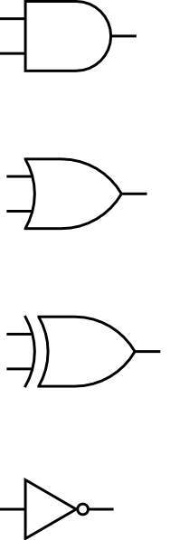
For Hardware implementation of Logic Operation
Select lines will select one of the 4 input and enable that as output.
i = 0,1,……..n ( n bit reg)
S0
S1
S1 | S0 | Ei | Operation
0 | 0 | Ai ˄ Bi | AND
0 | 1 | Ai * Bi | OR
1 | 0 | Ai + Bi | XOR
1 | 1 | Ai | Complement
Ai
4 X 1 MUX
Bi
0
1
Ei
2
3

Slide 83
Shift Micro-operations

Slide 84
Shift Micro-operations- Logical Left Shift:
In this shift, one position moves each bit to the left one by one.
The Empty least significant bit (LSB) is filled with zero (i.e, the serial input), and the most significant bit (MSB) is rejected.
The left shift operator is denoted by the double left arrow key (<<). The general syntax for the left shift is shift-expression << k.

Slide 85
Shift Micro-operations- Logical Left Shift:
Example:-
Left Shift denotes multiplication of 2
0 | 0 | 0 | 0 | 1 | 0 | 1 | 0
10
0
0
0
1
0
1
0
0
20

Slide 86
Shift Micro-operations- Logical Right Shift:
Example:-
Left Shift denotes Division of 2
0
0
0
0
0
1
0
1
5
0 | 0 | 0 | 0 | 1 | 0 | 1 | 0
10

Slide 87
Arithmetic Micro-operations- Arithmetic Left Shift:
Example:-
In this shift, each bit is moved to the left one by one. The empty least significant bit (LSB) is filled with zero and the most significant bit (MSB) is rejected. Same as the Left Logical Shift.
0 | 0 | 0 | 0 | 1 | 0 | 1 | 0
0
0
0
1
0
1
0
0

Slide 88
Arithmetic Micro-operations- Arithmetic Left Shift:
Example 2:-
1
1
0
1
0
1 | 0 | 1 | 0 | 1

Slide 89
Arithmetic Micro-operations- Arithmetic Right Shift:
Example 1:-
In this shift, each bit is moved to the right one by one and the least significant(LSB) bit is rejected and the empty most significant bit(MSB) is filled with the value of the previous MSB.
0
0
0
0
0
1
0
1
0 | 0 | 0 | 0 | 1 | 0 | 1 | 0

Slide 90
Arithmetic Micro-operations- Arithmetic Right Shift:
Example 2:-
1
1
0
1
0
1 | 0 | 1 | 0 | 1

